Slide 1
My BANK BANKING APPLICARTION
TEAM : FINANCE TITANCE
MODULE : PAYMENT TRANSFER

Slide 2
Agenda
Introduction
DB design
Flow Diagram
Jar file and git hub links

Slide 3

INTRODUCTION
The payment transfer module is a fundamental component within financial systems, enabling the movement of funds between accounts. This includes transfers within the same financial institution or between different institutions, as well as processing different types of payments like one-time, recurring, and scheduled payments.

Slide 4
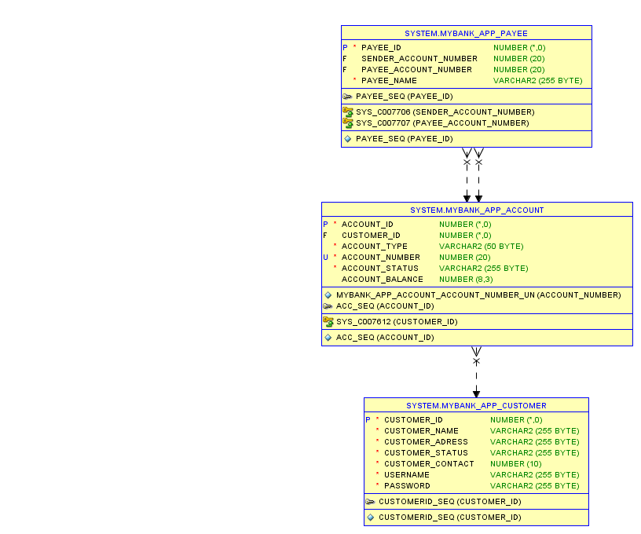
DB DESIGN

Slide 5
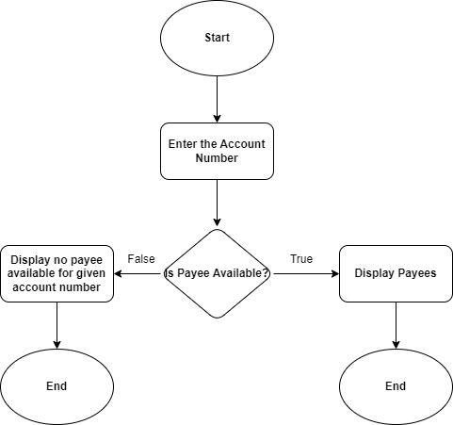
DATAFLOW DIAGRAM​

Slide 6
LINKS
Git Hub :https://github.com/Arundhathi-Nayak/DLTE-JAVA-FULL-STACK-ARUNDHATHI-NAYAK-2024/tree/master/PROJECT
Jar Files :
DAO : payment-0.0.1-SNAPSHOT.jar
Web Service : webservice-0.0.1-SNAPSHOT.war

